Slide 1
Why HP Networking?
Wesley Stephens – HPN AM
Jon Unruh – HPN Solutions Architect
Marvin Gentry – HP SLED Programs

Slide 2
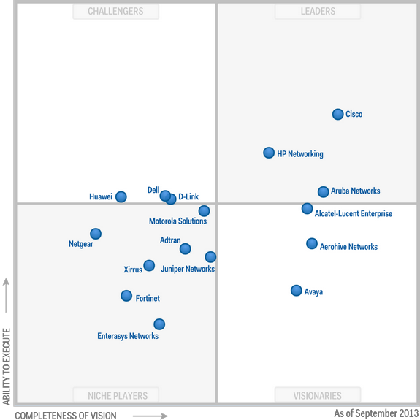
Why HP Networking?
Industry-Recognized Leadership In Networking Technology
SIMPLIFICATION
Gartner – Wired and Wireless LAN Infrastructure

Slide 3
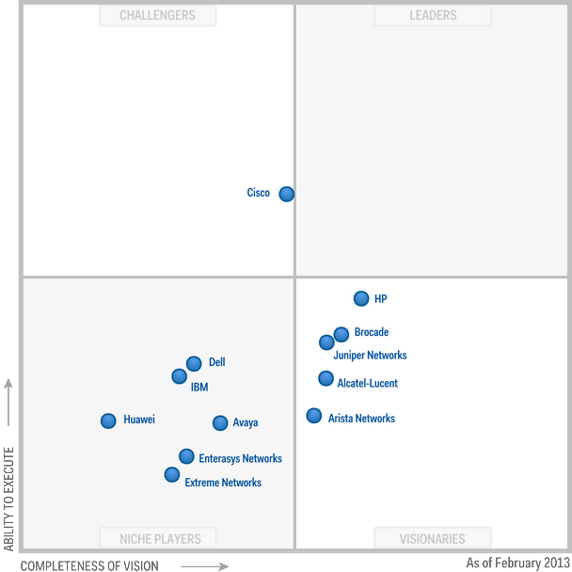
Why HP Networking?
Industry-Recognized Leadership In Networking Technology
SIMPLIFICATION
Gartner – Data Center Network Infrastructure

Slide 4
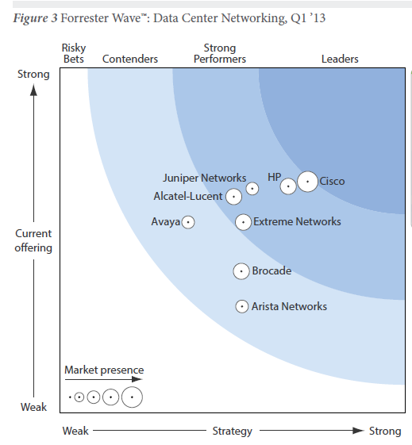
Why HP Networking?
Industry-Recognized Leadership In Networking Technology
SIMPLIFICATION
Forrester – Data Center Networking

Slide 5
Why HP Networking?
SIMPLIFICATION
Simplification
At HP Networking, everything we do is focused on simplification of the network.
HP simplifies, integrates and automates networking so organizations can focus on their core competencies.
Bethany Mayer, SVP and GM HP Networking

Slide 6




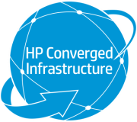

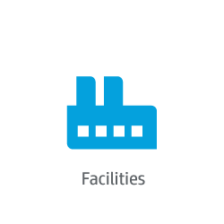










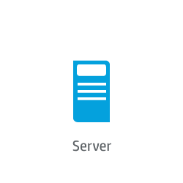
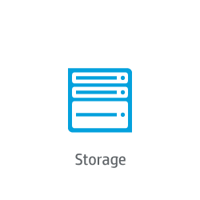
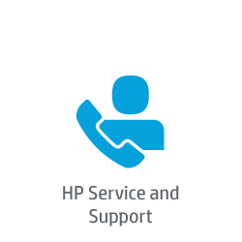




HP: we’ve changed the rules…to simplify networking
Industry Leading Innovation
Network Simplification
- Open Standards
- Convergence
- Virtualization
- Automation
Networking is the fabric of our Converged Infrastructure
Market Momentum
#2 Networking vendor and leading open-standards network provider
‘Visionary’ in Gartner 2013 Magic Quadrant for Data Center Infrastructure (ID:G00235303)
Gartner’s Mark Fabbi says HP is a “Formidable competitor across the entire enterprise networking market”
Check our references:
TCO
Simpler, automated architecture lowers capital and operational costs
Lifetime Warranty 2.0
3-year TCO studies, HP vs Cisco
Branch Office
Campus
Data Center
Transformation
TS Transformation Experience Workshops
Proof of Concept
Interoperability & Open Standards Leadership
Multivendor Network Management / Automation Tools
Training and Certification
Professional Services
58% less¹
Servers
Management
53% less²
Storage
Facilities
50% less³
Security
FlexNetwork Architecture
Services
Notes:
Gartner MQ Excerpt
“HP continues to enhance its data center networking capabilities, especially focusing on network management and automation. It leads the established networking vendors with its strong investments in and delivery of SDN and OpenFlow solutions, and its Virtual Application Networks solution can streamline network configuration from the data center to the desktop. HP's data center network revenue jumped 60% during 2011 (to $750 million), gaining nearly 4% of revenue market share, and we observed continued momentum during 2012. HP should be considered for the shortlists for all data center networking requirements, especially for organizations looking to simplify network operations and take advantage of SDN as part of their data center network evolution.”
Forrester Wave Summary
In Forrester’s words, “HP separated itself from the pack with a complete roadmap and vision towards delivering virtual network infrastructure functionality.” HP Networking earned the highest score of any vendor around data center simplification. IMC was highlighted as a leading management solution. Forrester stated that “HP takes a different approach and focuses on driving simplicity into operations, synchronizing virtual and physical networks, and integrating networking into the orchestration layer.” Forrester concluded its assessment by telling customers to consider HP Networking for their data center. Forrester stated that “HP has the pieces to enable customers to deliver high-quality business services, compliance, and cost-efficiency in today’s complex IT environments.”
10% Y/Y growth is all Switching PLs for period ending 2Q13
TCO
The calculus behind the numbers is simple. We are applying the levels of savings we have validated through the IDC study for hardware acquisition costs. These numbers are conservative and are based on a 1:1 replace exercise we conducted earlier this year to provide a baseline that reflects the minimum we believe we can get to. We have cases today where we have saved in excess of 40-50% compared to Cisco. The caveat to this all is we are making the assumption that Cisco sells somewhere in the 48-52% range but in this example showed a conservative 55% discount. Support costs are again conservative but some with some caveats. We believe 10% of HW cost is conservative but it is dependant on the level of support that P&G will require. Reality is if we use a heavier combination of stackables with lifetime warranty we will show significant savings beyond what is reflected. However, if there is a higher touch 24x7 4 hour repair and replace support required the price could be north of 10 but that will involve a more detailed conversation with P&G. The number reflected is probably closer to the latter scenario but again for the purpose of this exercise is a number we can defend.
Industry Leading Innovation
Changing Networking
Advanced Architecture
Secure
Agile Service Delivery
Lower TCO
Services & Education
Forward-looking leadership: Cloud, Converged Infrastructure, Green IT
Save Capital through Better Network Utilization
Fully active links help avoid the cost of over-provisioning
Save Money with Lower Total Support Costs
Industry-leading warranties and support options help reduce the lifetime cost of a customer’s network
Save Energy with Higher Density per Watt
HP products deliver higher density with less power, and up to half the energy consumption as compared to the nearest competitor
Take points from Take the fat out of networking presentation on TCO – Hardware & Customer
============
The HP Virtual Services Router or VSR is industry’s first Network Function Virtualization (NFV) technology.
10x faster time to revenue, Up to 87% operating cost reduction, 50% less power & rack space - compared to physical routers
Total
Total time to install, deploy, and ship with HP VSR Series is 10X faster than a physical router. Total deployment time is reduced from 7 days down to four hours.
Up to 87% OPEX reduction for simplified configuration/setup - reduce the total installation/deployment time from typically 4 hours down to 30 minutes. Services can be deployed at will without having to revisit the site (eliminating
multiple expensive specialized installs or “truck rolls” required to get your router up and running).
50% less physical foot print, rack space, power, and cooling. Total rack space, power, and cooling costs are reduced by up to 50% since you are now removing a physical router at each location.
TCO footnotes:
Based on list price for HP MSR50-40 hardware and software with 3-year maintenance vs. Cisco 3945 hardware and software with 3-year maintenance.
(2) Based on list price for HP 10500 core and HP 3800 edge hardware and software with 3-year maintenance vs. Cisco Catalyst 6509 core, 6509 distribution, and 3560 access hardware and software with 3-year maintenance.
(3) Based on list price for HP 12508 core and HP 5830 TOR hardware and software with 3-year maintenance vs. Cisco Catalyst 6509 core, 6509 distribution, and 4948 TOR hardware and software with 3-year maintenance.

Slide 7
Why HP Networking?
SIMPLIFICATION
Simplification – Software Defined Networking (SDN)
… SDN has the potential to eliminate the human middleware problem that has plagued network operations for the past two decades. By bringing network operations into more streamlined and automated operational processes…
Source: Gartner, Hype Cycle for Virtualization 2013, G00250781

Slide 8
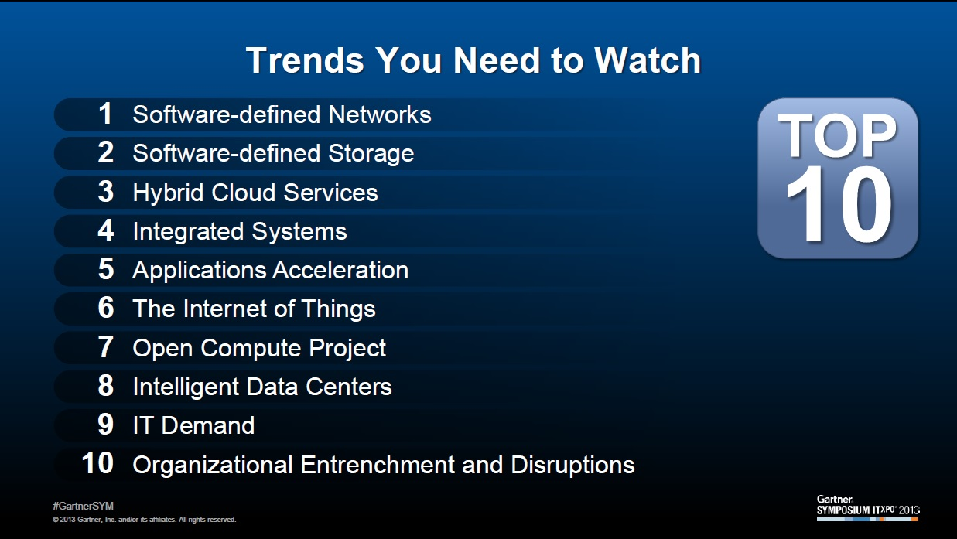
Gartner Trends to watch 2014

Slide 9
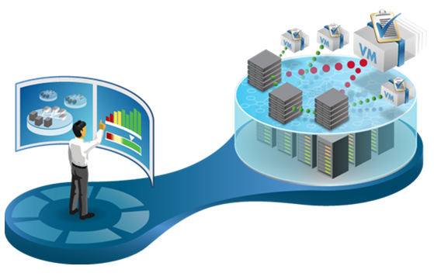
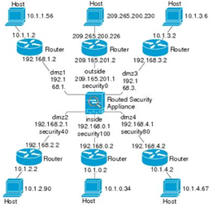
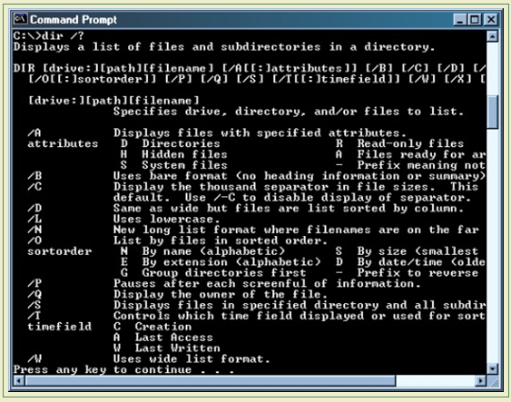
Simplification – Automation delivers agility
How & why
Command Line Interface
Software Defined Networks
CLI
Manual
Box-by-box
Human middleware
SDN
Business rules based controller
Automates and orchestrates the network
To deliver the right services for each user

Slide 10




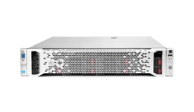

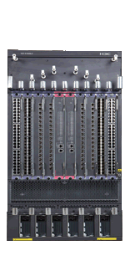


HP Software-defined networks vision
Business Applications
Deliver open programmable interfaces to automate orchestration of network services
Virtual Cloud Network
SDN Controller
Application Layer
Sentinal
Security
Enterprise
HP SDN Apps
Load balancing
3rd Party Apps
SDN Controller
Control Layer
VAN SDN
Controller
3rd Party Controllers
Open standard-based programmatic access to infrastructure
Network Device
Network Device
Virtual Switches
Infrastructure
Infrastructure Layer
Data Center
WAN
Campus/Branch
HP
3rd Party Ecosystem
Notes:
Virtual Application Networks represent HP’s software-defined network vision. HP is the only tier-1 networking vendor to offer a complete hardware and software SDN solution and open ecosystem .
By leveraging SDN-enabled infrastructure, control plane, applications and integrated management systems HP is creating an open ecosystem to drive new innovation in networking. HP is providing open interfaces for 3rd party integration as well as end-to-end solutions with
--Single-pane-of glass management for automation of infrastructure
--Open programmable access to infrastructure with OpenFlow
--Virtual Application Networks SDN Controller for centralized control plane
--SDN applications for Data Center, Campus and Branch
-- Offers open APIs for customers and 3rd parties to build applications and allows for business applications to interface directly with the controller for network-aware applications.

Slide 11
Legacy networks slow application deployment
System admin
Deploying Exchange VMs
VLAN 10
Are you ready yet?
Rack 3
Server 5
Subnet
.16.31
10M CIR
20M PIR
Priority
4
IP TOS
… ready!
Time in Months
…
250,000+
CLI entries
for typical
data center
Which
server?
Which
VLAN?
Which
subnets?
How much
bandwidth?
QoS
Priority?
QoS
Method?
Ok, starting switch config
Network admin (Layer 2-4)
Notes:
Let’s focus on the amount of time it takes to connect an application to the network. Let’s start with the tools that a server administrator uses. He uses tools that allow him to manage with policy. He has very sophisticated tools and when he needs to connect to the network, that’s where the delay comes in and it takes weeks.
Just look at the questions that a network administrator asks the server admin. These are much lower level questions. Because he isn’t using advanced policy-based tools. He is using 40-year-old technology comprising command-line interface and scripts. As a matter of fact, in an interview with a CEO, he told his team, “If you’re using the CLIN scripts, you’ve already lost the battle for cloud. “
In a typical data center, according to Cindy Borovick from IDC, you could have 500 servers with all of them running a hypervisor, each carrying about 20 virtualized workloads. Well, there are 10,000 workloads with each one requiring, on an average, five network attributes and there are 50,000 network attributes that you have to configure on a port-by-port basis across dozens of switches—possibly 250,000 command line entries across those dozens of switches. Even if you have a really good IT organization, those network administrators are bound to make a mistake.
Talking to Joe Skorupa from Gartner and his comment was, even if they are really good, they might make one mistake out of a thousand, that’s is still 250 errors and you’ve got to go find them—that’s the real tough part. This process is not only slow, but it presents a reliability problem.

Slide 12
Virtual application networks deploy apps in minutes
System admin
Virtualize
vCenter
Faster time to service
Deploying Exchange VMs
Virtualizing
Wow!
That was fast!
10-100x
Plug-in
… ready!
2
Application
deployed
in 3 steps
Application-centric deployment
Minutes
1
3
Simplified, template driven, repeatable cloud provision model
Characterize
Orchestrate
IMC VAN
Manager
IMC VAN
Manager
VMs
Network admin
Notes:
Let’s go back to our original example of deploying an exchange instance and its virtual machines.
Click #1: With Virtual Application Networks, the first step is to characterize the application delivery requirements for Exchange in the IMC VAN Manager Module.
Click #2: Here, we build a connection profile from a preconfigured template.
Click #3: The second step is to virtualize the server to network connectivity in VMware vCenter with a plug-in that comes with the IMC VAN Manager module.
Click #4: Here, the sys admin simply chooses the connection profile for Exchange. Every time a new Exchange instance is deployed, the same profile is selected, ensuring speed, consistency and reliability.
Click #5: The third step is to orchestrate the network with the IMC VAN Manager module where the Exchange VMs are visible after selecting the connection profile.
Click #6: By simply “powering them on,” IMC will automatically configure the switches based on the connection profile.
Click #7: The application is deployed in three easy steps!
And I never had to touch the command line interface!

Slide 13


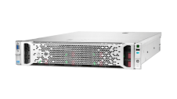






HBO: Sentinel Security Application Use Case
Campus & Branch Security
Data Center Security
Cloud Security
Application
Layer
Sentinel
Real-time Cloud Database Feed
Protection from over 2M Threats
DV Labs RepDV DB
Control
Layer
Virtual Application Networks SDN Controller
SDN Architecture
Infrastructure
Layer
Notes:
Imagine being able to stop threats in their tracks before they even reach your network. HBO is doing just that using HP’s Sentinel Security Application.
HBO is deploying Sentinel security across their campus network to protect their network from over 700 thousand malicious malware, spyware and botnet threats. At HBO, Sentinel works by redirecting DNS queries from user machines to the Sentinel application running on the HP Virtual Application Networks SDN controller.
Take for example a corporate user who was to click a link in an email:
First, the users DNS query would be sent to the local OpenFlow-enabled HP access switch
Second, the switch would forward the traffic to the HP Virtual Application Networks SDN controller via an OpenFlow rule implemented by the Sentinel application targeting DNS queries
Once the SDN controller receives the query, the Sentinel application jumps into action by checking the hostname against the HP TippingPoint DVLabs RepDV database of known threats. The DVLabs database ranks each domain name with a reputation score, and the IT administrator has the ability to set the threshold at which queries should be allowed to resolve.
Finally, If Sentinel determines that the site is legitimate, the query is forwarded normally across the access layer switch, however if Sentinel detects a threat, an unresolvable response is sent back to the client, the action is logged with HP ArcSight, and the user is prevented from accessing the threat.
HP’s Sentinel Security Application stops threats before they reach your network. Sentinel can be used in any network environment where security is a concern, including the data center and cloud computing environments. HP envisions a network where Sentinel security can be implemented on any network device anywhere in the network for unprecedented network visibility, event correlation accuracy, and security control

Slide 14
Simplification – Intelligent Management Center (IMC)
Unifies wired and
wireless networks
Multi-vendor
management
User Access
Integrated security
Applications
Full visibility
End-to-end
management
Services
Business efficiency
Virtual Network
Manages
over 6000
devices
Physical and
virtual networks
Infrastructure

Slide 15

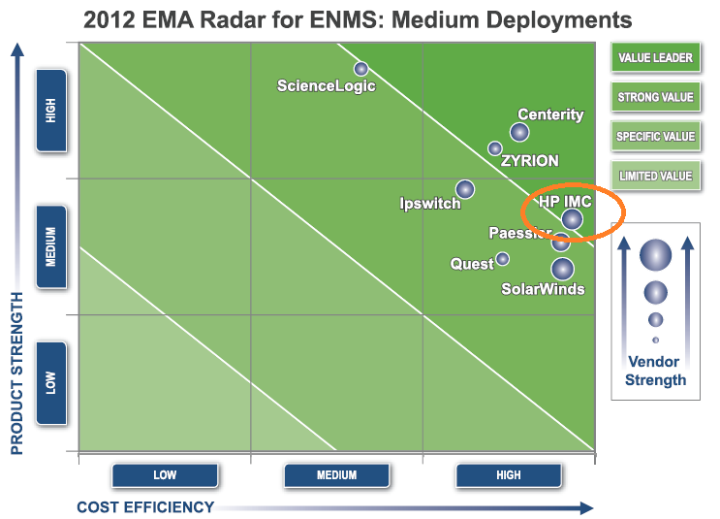
IMC – a Value Leader
Most cost effective solution – a benefit to any customer
    Customer interviews by EMA analyst have determined that IMC offers:
    Ease of deployment
    Lower total cost of ownership
    Low learning curve

Slide 16


Simplification – Lifetime Warranty 2.0
Always-on networks require round-the-clock support
24x7 Phone Support
Up to 3 years
+
FlexCampus
Hardware Warranty
Replacements
Software Updates
Phone Support
Lifetime
Next-Business Day
As long as owned
As long as owned
FlexBranch
Small Business

Slide 17



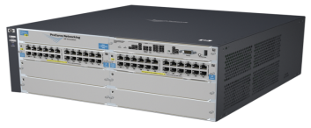
Simplification – LAN/WAN Interoperability
Integrated solutions with AllianceONE partners
Best-in-class application ecosystem
Centralized network management
Mobile and remote-site security
90%
600%
128%
Compared to Cisco
Catalyst 4506
Lower latency
Higher performance
Higher port density
Source: Tolly Enterprises, LLC
Notes:
In some cases as many as 75% of workers are outside the company corporate headquarters – but they are faced with poor application availability and poor performance.
The branch typically has limited staff and operates in a low touch (or even no touch) model.
Branches need pre-packaged equipment that can be dropped into a branch.
FlexBranch delivers a Plug and Play remote network which provides simplicity and convergence of functionality and services.
The FlexBranch solutions integrate best-in-class applications from a large ecosystem of alliance partners.

Slide 18


HP Services zl Modules for Virtualization
HP Services zl Module for Vmware vSphere 5.0
HP Advanced Services zl Modules for
  Vmware vSphere 5.0
  XenServer 5.6 SP2
Hardware Specifications
  Single slot HP Advanced Services zl module
    Intel Core 2 Duo Processor T9400 with 2.53 GHz and 3 MB cache
    Citrix module has 4 GB of DDR3-800 dual-channel memory installed
    VMware module has 8 GB of DDR3-800 dual-channel memory installed
    500 GB SATA II 7200 RPM hard disk drive
    Internal wire-speed 10 GbE ports to the switch backplane
HP Services zl Module for Citrix XenServer 5.6 SP2
HP Networking Lifetime Warranty
(HDD limited to 5 years)

Slide 19




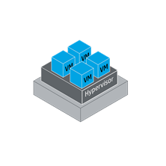
HP MSR Survivable Branch Communication Modules for Microsoft Lync 2013
All the benefits of a SIP media gateway
Plus survivability for Lync users at the branch
  Microsoft Lync Survivable Branch Appliance (SBA) software runs on HP MSR OAP module
  Various HP MSR OAP modules for scalability
    Small
    Medium
    Large
SIP
WAN
FXO
TLS
Voice T1/E1
SIP
TLS
HP MSR SBM for Lync
HP MSR Series
Router
FXS
LAN
Planned FY13Q3 - Microsoft Lync
Open Interoperability Program

Slide 20



Simplification – Convergence of Wired and Wireless
Wireless that performs like wired
Unified wired/wireless access control
Single-pane-of-glass management
Continuous RF vulnerability protection
Low TCO
Wired
Wireless
50% higher performance
Notes:
Enterprises can deploy WLAN services to users at near-gigabit speeds. With FlexCampus, enterprises can take a converged approach to security across all segments of the
network. With consistent identity-based access, businesses can secure traffic on their internal corporate wired and wireless networks as well as external traffic using a common platform and policies.
With class-leading security from HP TippingPoint, businesses can address today’s sophisticated security threats and protect critical assets before an attack causes an outage or data loss.
HP Intelligent Management Center (IMC) manages over 6000 network devices from 35 different manufacturers, enabling IT to seamlessly manage heterogeneous networks and help ease the migration to best-in-class network solutions. IMC not only bridges the gap between wired and wireless network management, but also between physical and virtual network management. For granular network and application access, IMC manages user access control and identity-based policies to not only make sure enterprises know who is on their network but what they’re doing when connected.
The result is that IMC speeds application and service delivery, simplifies operations and management reducing TCO

Slide 21
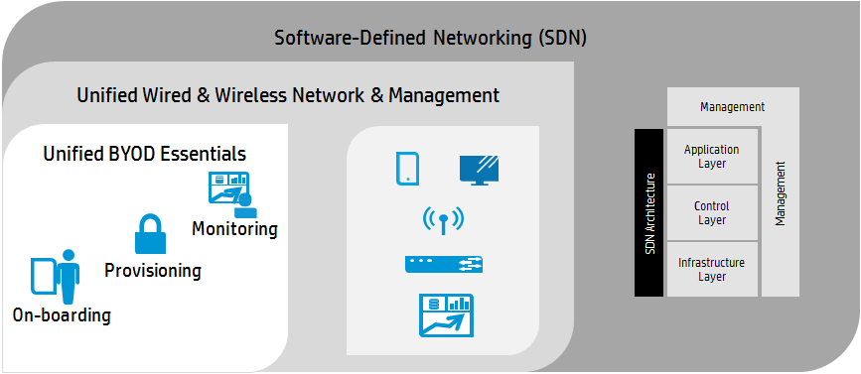
HP Networking – A Holistic Approach to BYOD

Slide 22
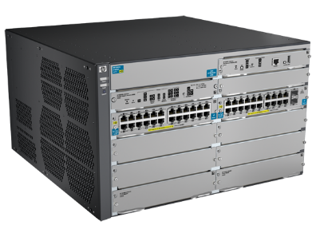
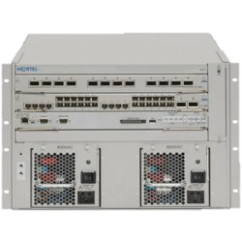
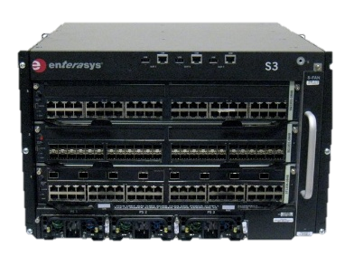
HP Networking Competitive Comparison
 | HP 8206zl Chassis | Avaya 8800 Chassis | Enterasys S3 Chassis
Feature comparison | 44 ports 1GbE + 2 ports 10Gb SFP | 48 ports 1GbE + 0 10Gb ports SFP+ | 48 ports 1GbE + 4 10Gb ports SFP+
Redundancy | Redundant Supervisors/Fabric | Redundant Supervisors/Fabric | No redundant supervisor Redundant Fabric
Advanced routing/features cost | No licensing costs (full L3 options, OSPF, BGP, etc.) | Additional cost for Advanced software features | Advanced software features $9995
Annual Maintenance | Free lifetime (as long as you own the product) | ~$5000/year | $2500/year maintenance
Expansion options | 1GbE-T & SFP 10GbE-T &SFP+ | 1GbE-T & SFP 10GbE-T &SFP+ | 1GbE-T & SFP 10GbE-T &SFP+
SDN Vision | Openflow capable today, in production in many schools and businesses Focused on Data Center and Campus | No vision outside the datacenter Lack of application centric approach | Leaning towards a proprietary solution Not available currently/behind the curve
Cost | $7993.70 | $39201.54 | $16607

Slide 23
Resources
Gartner SDN Report - http://www.gartner.com/technology/reprints.do?id=1-1NKA38H&ct=131202&st=sb
Forrester Data Center Report - http://www.forrester.com/pimages/rws/reprints/document/88361/oid/1-LXOGHT
Gartner Magic Quadrant for Data Center Network Infrastructure - http://www.gartner.com/technology/reprints.do?id=1-1E20SLP&ct=130212&st=sb
SDN White Paper - http://h20195.www2.hp.com/v2/GetPDF.aspx/4AA3-8562ENW.pdf
Open Network Foundation - https://www.opennetworking.org/
K12 Case Study around BYOD, SDN, and Sentinel - http://h17007.www1.hp.com/docs/byod/Ballarat%20Grammar%20v9.pdf
IMC overview video - http://www.youtube.com/watch?v=9ICqWBU_zUQ&feature=player_embedded
Lync Module Demo - http://h20621.www2.hp.com/video-gallery/us/en/products/2308408447001/hp-ucc-sdn-application-for-lync-demo/video/

Slide 24
Thank you / Q&A

