Slide 1
Next Generation Networks for K12 in Kentucky
Primary/secondary education
Monique Lucey
HPN Industry Solutions Marketing Manager, Public Sector
Notes:
I’m pleased to have the opportunity to discuss how HP Networking is changing the rules of networking with the HP FlexNetwork Architecture and how this is helping Educational institutions to develop the agile networks needed to improve improve learning and reduce IT costs.

Slide 2
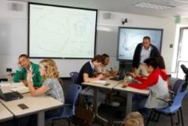
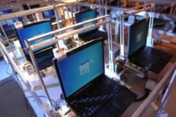
Education challenges
Increase quality time teachers spend with students
Maximize limited teaching resources
Reduce cost while increasing access to technology
Notes:
Let’s begin by jumping into the challenges that school systems around the globe are facing today.
As schools around the world push toward the everyday use of sophisticated technologies that can help them compete for top-notch students, faculty, and funding, accelerate literacy and improve graduation rates, they are rethinking their legacy—and, in many cases, proprietary—infrastructure approaches.
Pressure for schools to prepare students for the real world has reached unprecedented levels. However, school districts face many challenges in their adoption of technology and have a difficult balance to strike—offer open, accessible networks that can support real-time, resource-intensive, and collaborative applications without jeopardizing performance or security. This problem is especially difficult to solve since most school districts have a combination of legacy and new applications running on disparate, proprietary networks, creating interoperability, visibility, and security problems.
At the same time, school budgets and resources are constrained. There typically is no option to add staff. Instead, IT organizations must find ways to utilize current resources and staff more efficiently.
Additionally, increased access to student records—complicated by extensive use of mobile devices—invites cyber attacks, potentially jeopardizing student privacy and compliance with the Child Internet Protection Act (CIPA). Security breaches also can put student safety at risk by crippling emergency notification and video surveillance systems. The potential for network users to access and download unauthorized content further fuels the need for proactive, multi-layered security.

Slide 3
Education networks are at the breaking point
Disjointed networking architectures
Lack of standards adherence at critical network boundaries
Too many layers, too many devices, too many OSes
Legacy networks stifle innovation and collaboration
Constrained scalability from data center to campus
Poor multimedia performance
Inconsistent wired and wireless experience
Inconsistent security from the cloud to the user
Unable to secure the virtual environment
Limited connection between business policies and the network
No consistent view into the physical and virtual worlds
Non-federated, serialized workflows
Swivel-chair management
Virtualization
Cloud
Data explosion
Mobility
Multimedia
Less than 30% of IT spend is focused on innovation
Notes:
Today’s legacy networks are not equipped to handle the demands of these new government initiatives. In fact, many public sector networks are at the breaking point.
It’s all too common to find disjointed networking architectures.
Historically, organizations have taken a siloed approach to problem-solving
And they are using Inconsistent underlying technologies
This results in increased operation complexity and cost. Given educational institution’s limited staff and funding, it is particularly important that the IT teams are very agile, that they can move from one IT initiative to another.
Legacy networks are often oversubscribed. They are using layers of unnecessary devices.
Their limited scale results in poor multimedia performance
And an Inconsistent wired and wireless experience
These issues can inhibit innovation and collaboration such as distance learning in schools, videoconferencing initiatives, the use of wireless technology in the classroom and across campuses.
Legacy networks are based on physical services and resources.
They don’t provide VM-level network protection, making it difficult to secure the virtual and private cloud.
Finally , legacy networks don’t provide a consistent view into the physical and virtual worlds. They are using multiple, disaggregated tools and swivel chair management.

Slide 4
Architectural leadership with FlexNetwork
FlexFabric | FlexCampus | FlexBranch
Converges and secures data center network, compute, and storage in the physical and virtual worlds | Converges wired and wireless networks to deliver secure identity-based access | Converges network functionality, security and services for simplicity
FlexManagement
Converges Network
Management &
Orchestration
FlexFabric
FlexCampus
FlexBranch
FlexManagement
FlexNetwork Architecture
Open | Scalable | Secure | Agile | Consistent
Notes:
To address these challenges, HP unveiled the FlexNetwork architecture in May, 2011.
The FlexNetwork architecture enables enterprises to fully harness the power of media-rich content, virtualization, mobility and cloud computing.
It’s a unified network architecture that spans across the data center, campus and branch.
It’s open and uses industry standards to support full network integration.
It scales on the dimensions of functionality, connectivity & capacity.
It uses award-winning vulnerability solutions & research through HP VDLabs.
It’s agile for increasingly virtualized applications, rich media & for public and private clouds.
Reduces complexity with single pane-of-glass management for physical & virtual environments.

Slide 5
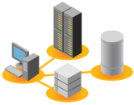
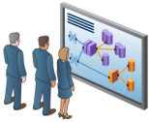
Best-in-class networking in a converged infrastructure
A comprehensive solution only from HP
Storage
Servers
Converged Infrastructure
Power and cooling
FlexNetwork
Architecture
Management software
Notes:
HP’s FlexNetwork is part of the HP Converged Infrastructure. The Converged Infrastructure overcomes IT sprawl by breaking down the IT silos and bringing resources together into pools of virtualized assets that are shared by many applications and services. The solution to sprawl lies in a converged infrastructure that reunifies business, application, and infrastructure functions.
We’re also talking about bringing together management tools and processes so resources can be managed in a holistic, integrated manner. And we’re talking about bringing together power and cooling approaches so systems and facilities work synergistically to make better use of energy—a huge cost area for data centers.

Slide 6
Benefits
Open
Industry standards adherence for assured network integration
Scalable
Scales on the dimensions of functionality, connectivity & capacity
Secure
Award-winning vulnerability solutions & research through HP DVLabs
Agile
Fast service delivery for virtualized applications, rich-media & cloud
Consistent
Single pane-of-glass management for physical & virtual networks
Notes:
Standards adherence across the entire portfolio for assured network integration
AllianceONE partner-developed network applications for best-in-class networks
Feature richness scales to accommodate highly complex environments
Network performance scales from the remote site to the multi-terabit core
Common underlying OS for consistency in configuration and management
Network orchestration tools manage both HP and other vendor equipment
Reducing the tiers of network equipment in both the data center and campus
Simplified orchestration enables rapid changes to adapt to business needs
Reducing the tiers of network equipment in both the data center and campus
Simplified orchestration enables rapid changes to adapt to business needs

Slide 7
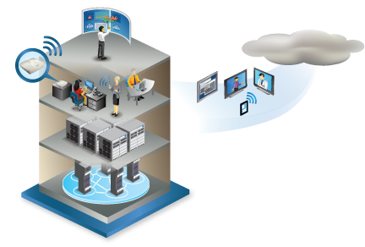
FlexCampus revolutionizes multimedia and collaboration
Converged wired & wireless
Comprehensive, unified portfolio of high-performance wired and wireless access solutions
Converged service orchestration
Single pane-of-glass management from the edge to the core
Simplified architectures
Optimized 1- and 2-tier networks reduce latency and increase resiliency
Pervasive security
Industry-leading research powers best-in-class threat protection
Comprehensive identity management and endpoint security
Notes:
Communications is undergoing drastic change fueled by rich media applications like webcasts, video-enabled customer service, video
conferencing, video‑on-demand training, and IP surveillance and security. Education institutions are embracing technology to deliver innovative learning applications and services and enable teachers to spend more quality time with each student. Consider rich media communications impact on education: video conferencing reduces travel costs and increases the pace of learning as students and faculty collaborate globally.
FlexCampus allows enterprises to converge and secure wired and wireless LANs to deliver consistent, video-optimized, identity-based networks.

Slide 8
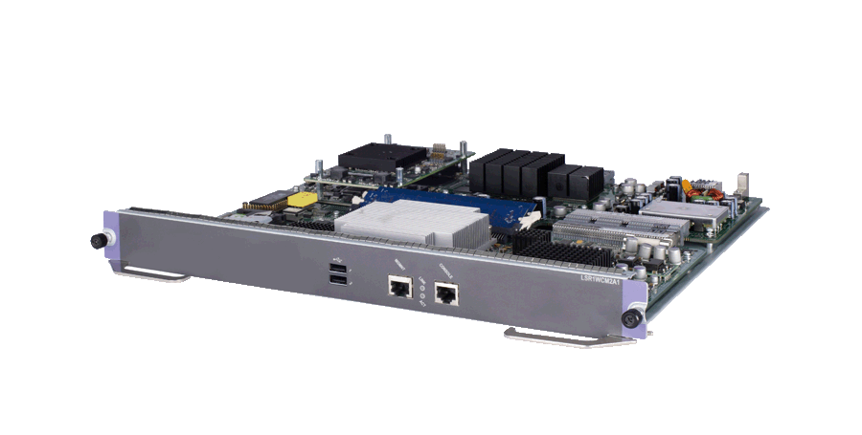
FlexCampus Solution portfolio
Routing
Switching
Wireless
Security
FlexCampus Core
Switching
Wireless
Security
FlexCampus
Edge
FlexManagement
Intelligent Management Center
Notes:
3/4/2013
HP Confidential
8

Slide 9
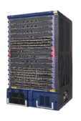
FlexCampus simplifies the campus LAN
Innovative 2-tier architecture with the Intelligent Resilient Framework (IRF)
Building 1
Building 2
Building 3
Building 4
85% reduction in management complexity
Manage 5 virtual switches with IRF vs. 42 physical switches
Flattened architecture – 2 tiers with no aggregation
Embedded WLAN controller further reduces complexity and cost
Notes:
FlexCampus is based on an advanced two-tier architecture that improves the performance of media-rich collaboration by eliminating latency and accelerating the network as a whole. Simplifying the campus network by eliminating the distribution layer improves performance even in very large networks, simplifies the network and cuts costs. Half of the ports in a legacy three tier architecture are used to interconnect switches, and the architecture, along with the use of Spanning Tree, impedes performance and network availability.
Simplifying the network can reduce the number of discrete network elements to purchase, deploy, power, cool and manage by up to 85%.
With FlexNetwork architectures, organizations are free to build their campus networks to support user requirements for flexibility and mobility. HP uses industry-standard protocols and protocol implementations at the boundaries, which ensures interoperability with the freedom to customize the network design to specific functional requirements.

Slide 10
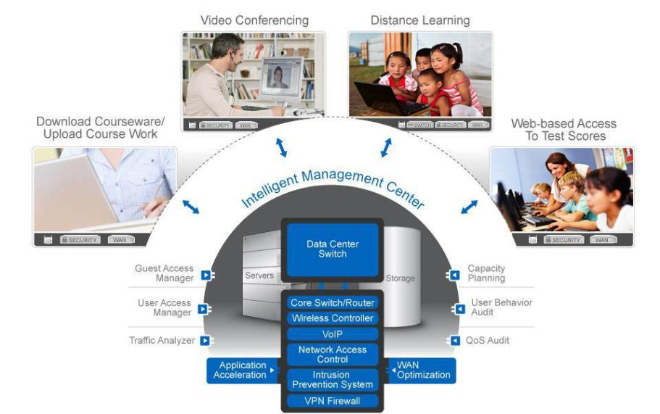
Increase quality time teachers spend with each student
Notes:
Over the past few years, classrooms have come alive with rich experiences for learning. Teachers are able to roam about, engaging students like never before. Administrators can go room to room, observing lecture styles and jotting down notes. Children can reach out to their peers around the world and shrink the distance via face-to-face video conversations. And instructors with discipline specialties can reach students in rural and urban districts alike.
To say this era of education is vibrant and thrilling would be an understatement. Opportunities abound everywhere for students throughout the grades to connect with materials in ways never imaginable before. They can interact via video, voice, the Internet, rich media, social networking and components of the digital classroom. Students, faculty and staff all want to access wireless networks – via their own devices or those provided by the school – to enhance learning.

Slide 11
Enabling e-Learning initiatives with unified wired and wireless networks
Wireless that performs like wired
Single-pane-of-glass management
Unified wired/wireless access control
Continuous RF vulnerability protection
Compelling TCO
Wired
Wireless
Notes:
Over the past few years, classrooms have come alive with rich experiences for learning. Teachers are able to roam about, engaging students like never before. Administrators can go room to room, observing lecture styles and jotting down notes. Students can reach out to their peers around the world and shrink the distance via face-to-face video conversations. And instructors with discipline specialties can reach students in rural and urban districts alike.
Opportunities abound everywhere for students throughout the grades to connect with materials in ways never imaginable before. They can interact via video, voice, the Internet, rich media, social networking and components of the digital classroom. Students, faculty and staff all want to access wireless networks – via their own devices or those provided by the school – to enhance learning.
HP converged infrastructure wired and wireless infrastructure offers wireless throughput and relaibility that performs like wired, consistent access control implementation plus wireless IDS/IPS (this is specific to radio frequency (RF) intrusions). These are all wrapped up with a single management app. Wrapped around everything is our network IPS solution from TippingPoint, with the DVLabs team identifying and protect vulnerabilities in HP Software.
HP Innovation include an
Optimized architecture
Controllers support both distributed and centralized data path
Breakthrough economics
Technical evolution at prices comparable to current technology; lifetime warrantee
Open industry standards
Access Points are Wi-Fi Certified, which assures interoperability
Convergence
Unified wired/wireless solution
Blade for switching chassis, with unified management
Single pane-of-glass management
Single management application for both wired and wireless network
Integrated security
Set security once for your wired/wireless network

Slide 12
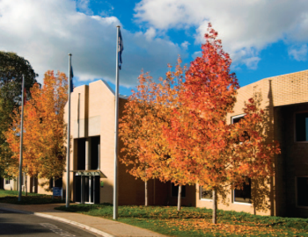
Education mobility challenges
Learning & staff efficiency
Mobile generation
Privacy and security
Interactive whiteboards
Classroom and virtual
Research & development
Devices infiltrate classes
On demand learning
Anywhere at anytime
Ensure students safety
Compliance (i.e. PCI)
Guard campus assets

Slide 13
HP Mobility Solutions to address these challenges
Learning & staff efficiency
Mobile generation
Privacy and security
High performance access to multimedia learning
Voice & multi-media for student & staff collaboration
Guest access for visitors
BYOD unified access & policy enforcement
Secure network authentication & encryption
Wired and wireless IDS/IPS for privacy & compliance
Campus video surveillance
Notes:
As mentioned on the previous slide, IT and users alike will be best served if an enterprise takes a step-wise approach to moving to an all-wireless edge. By doing this, they will materially reduce the risk of unintended poor network performance leading to a bad user experience
Here is a more detailed look at how this transition might map out.
The first step is something that many enterprises are working towards today: Unify their Wired and Wireless Access. An enterprise can make material progress in reducing capex and opex by implementing a networking solution that seamlessly integrates wired and wireless. This integration includes hardware integration, single pane network management, unified policy and security and more – a good way to think about it is that wireless should be just another service of the core networking system, much like routing, security and other services that the networking platform offers.
Once the network access is unified, the exercise of reducing redundant access is simplified - a common network management toolset and configuration paradigm is place – so, managing the cutover to reliance on wireless is easier and risk reduced.
HP is very well positioned to deliver this solution today – most WLAN vendors cannot provide a unified wired and wireless solution.
Once the networking solution is unified, the process of peeling back wired access where and when it makes sense is simplified. An IT Mgr can then begin to evaluate where within the network he can rely upon only wireless immediately based on application needs and resilience requirements, and start to eliminate or repurpose wired switches over time.
At some point along the transition path, it will become evident to the IT Manager that he has eliminated as much wired networking as his applications allow or that he is comfortable with at that time. From that point on, periodic evaluation will allow an IT Manager to further streamline the network by reducing more wired networking when he is comfortable that WLAN technology can accommodate his requirements.

Slide 14
High performance wireless access
Enable e-learning initiatives
Access to critical learning applications
On-demand access to e-learning test scores and coursework
Fast access to distance learning
Enhanced student teacher collaboration
Extend access to outdoor school campuses & sports facilities
Enhanced coverage and reliability
GbE WLAN client access with three-spatial-stream dual 802.11n
Supports high density deployments, voice and video
Band steering and beam forming improves client performance
Beam forming reduces improves coverage
Optimized architecture – distributed and centralized traffic
50% higher user density

Slide 15
Real-Time voice and multi-media support
Identity-based, fast-handoff roaming for reliable VoIP communication
QoS enforced at network edge for end-to-end prioritization
Wireless Multimedia (WMM) and WMM Powersave
Voice not impacted by intrusion scanning
Application based QoS
Enhanced throughput (450 Mbs/radio) and reliability for video
Distance learning, research, staff interaction
Concurrent 5Ghz operation (channel availability)
Wireless video surveillance for student campus safety
Improve staff efficiency with voice, UC and video conferencing
Collaboration and instant notification with emergency notification systems

Slide 16
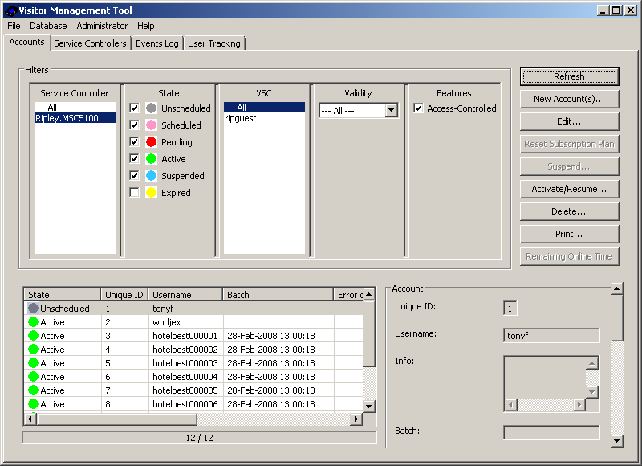
Guest wireless access management
Create a differentiated experience
Provide internet access to adjunct faculty, vendors and visitors to campus
Securely segment guest access from the school network
Authorized non- IT staff can easily and quickly create guest user accounts
Access controller supports end user authentication, and home page redirects
Notes:
HP guest management software allows non-technical individuals to add guests per day, per hour, or for a limited amount of time, temporary access to the network. For example, it gives the flexibility to the administrator to allow guests network access in a hotel lobby.

Slide 17
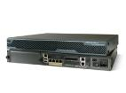
Unified access and policy enforcement for BYOD
IDM Identity Driven Manager
Event status drill down
IDM agent status
Log-in success/failure history
Number of users logged in
Policy Group assignment
Unified wired/wireless access control
Dynamic policy assignment and provisioning
Access rules based on time of day, location, device type, end point integrity
Maintain security and compliance
Centrally monitor and keep records on all users/devices
Network access reports to assist in compliance
Control mobile devices requesting access
Simplified self registration portal option
Identify device types and classify them
Simplified deployment
Consistent management for wired/wireless infrastructure
No specialized security appliance or subscription costs
IDM
Wired
Remote
Wireless
Employee
Devices
Guests

Slide 18
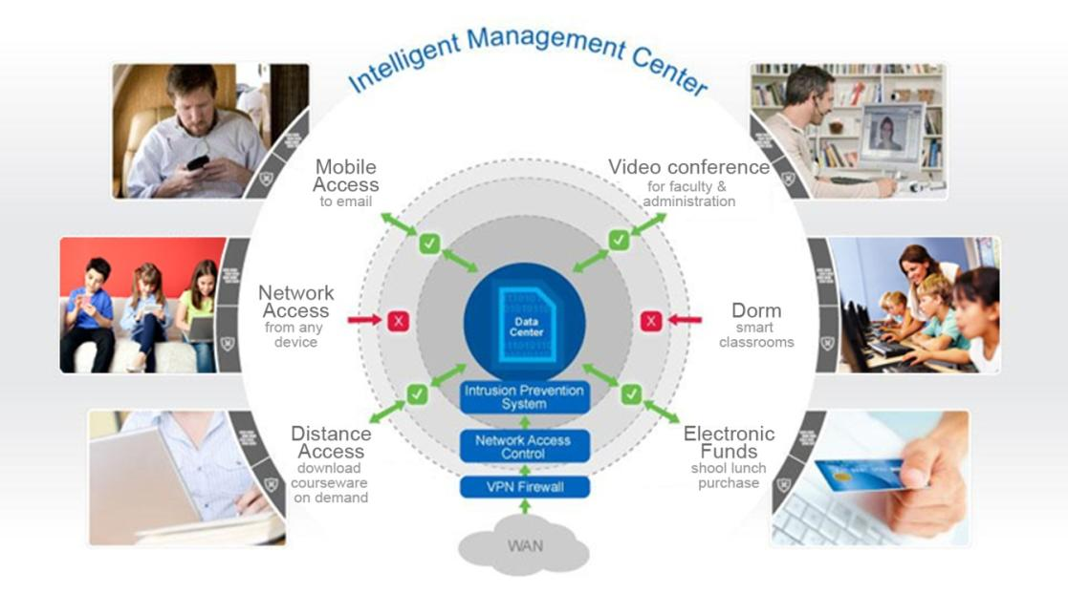
Maximize limited teaching resources
Notes:
Primary-secondary education as a whole is under tremendous pressure to improve educational quality by expanding the amount and types of services it offers, while simultaneously decreasing costs and increasing data protection in an open environment that fosters learning but, does so in a way that is safe and secure – IT in general has a big part to play in that mission. The network infrastructure, in particular, is being leveraged for anywhere/anytime access to course material, learning aids and student information.
The wealth of freely available information on the Internet has taken study and research to whole new level, but this brings with it a myriad of risks. With such an open environment, these threats can equally come from inside as well as outside the campus. So education security needs to evolve from just policing the WAN, to keep the bad guys out, to verifying, authorizing and policing legitimate users and only granting appropriate access.

Slide 19
Security at the network edge
Prevent malicious attacks, protect student information, ensure compliance
In-depth security including 802.1X authentication, WPA2 encryption – only allow authorized users on the network
Wireless IDS/IPS for continuous vulnerability protection , rogue detection and comprehensive compliance reporting (PCI)
Highly accurate threat classification eliminates false positives
Access control segregates guest high-speed Internet traffic from backbone network
Wireless scanning does not interfere with voice communication
✓
Encrypted
✓
PCI compliance for payments & campus debit cards
Threat Control
✓
Access Control

Slide 20
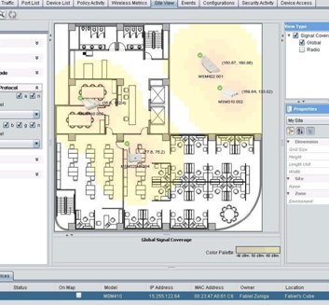
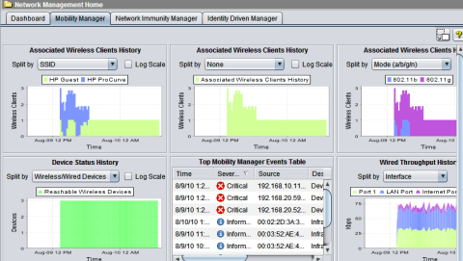
One network, one tool, one view
Faster time to service
Templates expedite provisioning and deployment
Configure multiple access points centrally
Greater network visibility
Instant access to status of hundreds of wired/wireless devices from a single screen
Tracks wireless device status, network performance, and user connections for up to 2,500 devices
Plug-in to HP software
Mobility Manager is a plug-in to PCM+
Mobility Manager v3.10
HP Confidential

Slide 21
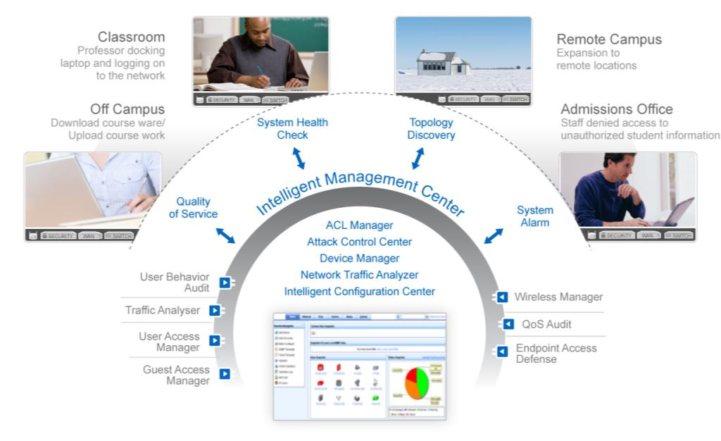
Reduce cost while increasing access to technology
Notes:
As many school systems consider how best to deploy new wireless networks and look to consolidate their existing network infrastructure, they are challenged by the need to manage and secure disparate systems. Addressing these issues is critical since lapses in management can lead to security breaches and network outages that have serious repercussions, such as public disclosure of student information, unauthorized access to student health records, or interruptions in classroom learning.
Such chaos can make it difficult for IT teams to support contemporary learning environments such as media-rich interactive courses, distance learning, and one-to-one computing, as well as essential services such as emergency notification systems and administrative services. The disjointed nature of legacy networks also inhibits cost-saving measures such as automating student lifecycle management and physical asset management.

Slide 22
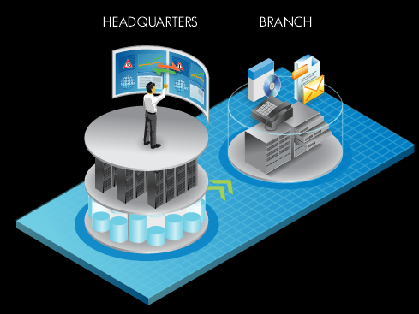
FlexBranch revolutionizes the branch office
LAN like experience
Simplified branch communications
Integrated network and applications for simplicity in service delivery
Converged service orchestration
Single pane-of-glass management from the edge to the core
Optimized application delivery
Accelerated WAN and cloud access and optimized local applications
Pervasive security
Industry-leading research powers best-in-class threat protection
Comprehensive identity management and endpoint security
Notes:
School districts can converge and secure their wired and wireless LAN services for greater simplicity and higher functionality with FlexBranch modular building block of the FlexNetwork architecture. The FlexBranch provides all of the necessary services to provide connectivity to branch offices for a headquarters-like user experience, at the same time simplifying remote-site management.

Slide 23
FlexBranch solution portfolio
MSR50
MSR30
MSR20
MSR900
Routing
5400
5800
3500
5500
2910
MSM430
Access
MSM460
Firewall
TMS
IPS
RF Manager
Security
Applications
Services
Notes:
3/4/2013
HP Confidential
23

Slide 24
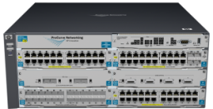
FlexBranch delivers the plug & play remote network
Converges network functionality, security and services for simplicity
Best-in-class application ecosystem
Centralized network management
Mobile and remote-site security
5400 & 8200: Industry’s first converged branch solution integrating best-in-class applications
Notes:
In some cases as many as 75% of workers are outside the company corporate headquarters – but they are faced with poor application availability and poor performance.
The branch typically has limited staff and operates in a low touch (or even no touch) model.
Branches need pre-packaged equipment that can be dropped into a branch.
FlexBranch delivers a Plug and Play remote network which provides simplicity and convergence of functionality and services.
The FlexBranch solutions integrate best-in-class applications from a large ecosystem of alliance partners.

Slide 25
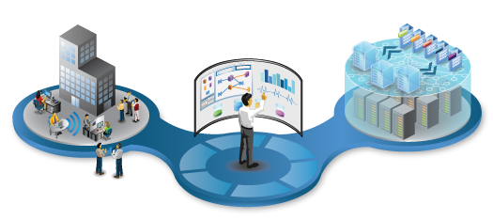
Managing FlexNetwork
Single pane-of-glass management that expands to virtual elements and federates with server orchestration
Intelligent Management Center v5
Notes:
FlexManagement allows IT to gain new efficiencies and higher levels of control by converging network management and orchestration. Instead of turning to myriad discrete network management tools, IT staff can use HP Intelligent Management Center (IMC) for single pane-of-glass management across heterogeneous networks. IMC provides full fault, configuration, accounting, performance and security management and scales easily from small to very large deployments.

Slide 26
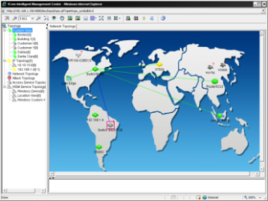
Intelligent Management Center
Single pane-of-glass management for HP’s FlexNetwork Architecture
Single pane-of-glass, multi-vendor network management from access to core
Consistent views into the physical and virtual worlds
Converged wired & wireless network management
Integrated user security and policy management
2600 devices supported
From 35 manufacturers
… and over 1000 are from Cisco
Notes:
IMC bridgest he gap between managing physical and virtual networks – which is a significant challenge- and also provides converged management for wired and wireless LAN management across the campus. IT can enforce consistent, identity-based security controls with a single system for both network access control and identity management.
IT staff can use IMC to manage both their HP and legacy networks. IMC manages 2,600 network devices from 35 manufacturers. IMC integrates with HP software today, and its SOA architecture allows federation with other orchestration tools.

Slide 27
HP Networking
Leadership from edge to the data center core
FlexFabric
Routing
Core
Aggregation
Edge/Server Access
Security
FlexCampus
Routing
Core
Aggregation
Edge
Wireless
Security
FlexBranch
Routing
Switching
Wireless
Security
FlexManagement
• Intelligent Management Center
• Operations Automation and Orchestration
• Network Node Manager
Services
• Operations Center
Notes:
HP Networking now has an incredibly broad networking and security portfolio all the way from the edge of the network to the very core of the data center.
HP also provides single-pane-of-glass management and a broad range of services for our networking customers.
We have a robust and highly competitive networking technology with industry leading innovations.
This year, we’ve introduced many new products to our family.
Let me show you what some of these products look like and what we really mean by true innovation.
3/4/2013
HP Confidential
27

Slide 28
Driving innovation
1977
Ethernet patented
#4063220 by 3Com founder Bob Metcalfe
1987
HP invents 10BASE-T
1990
HP intros 10BASE--T stackable hubs
1993
HP offers lifetime warranty
1999
HP ships 1000BASE-T switch
2006
TippingPoint Zero Day Initiative
2008
HP #2
2010
HP launches HP Networking
2011
HP launches FlexNetwork Architecture
2010
HP earns leader quadrant in Gartner’s Magic Quadrant
1977
2000
Getting Started
Leading the Industry
1982
3Com shipped first
Ethernet adapter
1998
3Com intros industry’s first pure SIP PBX
2006
HP supports LLDP & LLDP-MED
1981
3Com shipped first
Ethernet transceiver
1995
3Com launches CoreBuilder
2005
HP drives LLDP & LLDP-MED standard
2011
HP ships 1st Energy Efficient Ethernet switch
1992
3Com demonstrates 100Mbps Ethernet
1980
3Com first product UNET, UNIX TCP/IP Software
1994
3Com launches SuperStack
2000
HP Switch on a chip
2010
HP ships 1st PoE Plus switch
Mergers & Acquisitions
3Com H3C Joint Venture 2003
3Com Acquires TippingPoint 2005
3Com Acquires H3C 2007
HP Acquires Colubris 2008
HP Acquires 3Com 2010
Notes:
HP is the largest IT provider in the world and HP has a long history of innovation.
HP acquired 3Com in 2010.
And as you can see, both HP and 3Com have a long and rich history of networking innovation.

Slide 29
Momentum

Slide 30
Data Centers powered by HP
HP is All HP
Deployed in months
6
With
NO
With
4x
IN SIX DATA CENTERS
replaced all routers & Switches
Data Center down time
The previous bandwidth
All on open standards
Notes:
HP evaluated and tested all of the products in the 3Com portfolio prior to the acquisition.
Based on the test results, HP purchased 3Com and migrated to an all HP-network.
HP’s 6 next generation data centers converted to HP Networking in under 6 months with no down time and 4 times the previous bandwidth.

Slide 31
HP Networking is making an impact
75%
of the participants said HP is part of the discussion now
33%
said HP is influencing deal terms and winning over Cisco
Source: Baird “IT Systems and Networking Cisco Var Survey, July 2011”

Slide 32
Switching market – 2 year trend HPN vs. Cisco
+3.8
Networking
-6.5
Source: Dell’Oro and HP; Revenue: 3QFY2008 – 2QFY2011; Market Share: 3QCY2008 – 2QCY2011; HP Share normalized for acquisition
HP
Cisco

Slide 33
Growing faster than market
Switching | WLAN | Routing | Security
3.7X | 4.9X | >15X | 1.7X
Sources: Dell’Oro Group , Infonetics & HP (CAGR CY08 – CY10)
Notes:
2009 and 2010: HPN growing faster than the industry across all major areas of networking despite the recession.

Slide 34
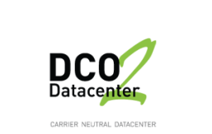
… And earning customers
Notes:
And HP Networking has earned enterprise customers in every region and in every country.
In fact, half of the Fortune 100 and Global 100 companies use HP FlexNetwork solutions, including every telecom company on both lists.
HP FlexNetwork solutions are used by 86% of all Aerospace & Defense companies on the Fortune 100 list.
HP FlexNetwork solutions are used by 82% of all Automotive companies on the Global 100 list.
HP FlexNetwork solutions are used by 63% of all Electronics companies on the Global 100 list.

Slide 35
Gilbert public schools
Overview
Located in the Phoenix, AZ school district
Gilbert, a suburb of 200,000 people has the fourth largest school district in the state
38,000 preschool, elementary and high school students, 2,300 teachers and 110 administrative employees
Gilbert was named one of the best places to live and learn by GreatSchools.org
“Given the two competitive options, the choice to go with HP Networking was crystal clear.”
Barbara VeNard, Assistant Superintendent of Educational Services, Gilbert Public Schools
Notes:
Let’s take a look at how Gilbert Public Schools is using HP networking solutions to transform the learning experience.

Slide 36
Gilbert public schools
Challenges
Upgrade aging network throughout schools and administrative facilities to increase bandwidth
Improve security and expand wireless coverage for easier and more reliable access to advanced teaching and administrative applications and digital tools
Notes:
Gilbert had a couple of key challenges they were trying to address.

Slide 37
Gilbert public schools
Business outcomes
Gilbert Public Schools saved more than $2 million compared to a quote from Cisco
Improved network dependability for critical teaching and administrative tasks
Provided “anytime, anywhere” broadband access to multimedia for students and teachers and administration
Notes:
With the new network in place, Gilbert’s students, teachers and administrators are using the Internet and digital communications to their full potential. Now, students and teachers can easily view multimedia course material online, listen to podcasts, or video-conference with scientist or students around the globe. Some high school teachers, for example, are looking into developing “flat classrooms” that make use of Web 2.0 technologies to integrate courses with classrooms in other countries.
Administrators are also benefiting from the new network. Thanks to HP’s full-featured switches, the network supports multicast technology, which allows the school district to easily “broadcast” video programs and podcasts throughout the district or run videoconferences, such as providing administrative updates to teachers and staff, or explaining new policies to students.
Also, thanks to the network’s reliability and bandwidth, the school district has been able to begin upgrading its student information system from an aged command-line “green screen” application to one with a graphical user interface and modern database design, making it much faster and easier to process and access student records.
So what were the business outcomes for Gilbert?

Slide 38
Thompson R2-J School District
Objective
Update the school district’s 10-year-old heterogeneous network
Approach
Deploy HP ProCurve solutions at 34 locations
Results
Saves $20,000/yr. in support
Saves $300,000-$500,000 acquisition costs
$100,000 savings applied to other projects
3-yr. ROI
50% better switching performance
Firmware updates in 6 hrs. vs. 2 weeks
Notes:
About the Thompson R2-J School District
Near Rocky Mountain National Park and Roosevelt National Forest in Loveland, Colorado, the Thompson R2-J School District affords natural science exposure in addition to a strong K-12 curriculum for 15,265 students. Colorado’s 16th largest school district comprises eight early childhood centers, 19 elementary schools, five middle schools, five high schools, and one charter school.
Objective
Update the school district’s 10-year-old, heterogeneous network
Approach
Build a high-performance network backbone by deploying HP ProCurve solutions at 34 locations, including 50 HP ProCurve Switch 5400zl, 5406, and 5412; 50 HP ProCurve Switch 1800 Series; 30 HP ProCurve Switch 3500 Series; 30 HP ProCurve Switch 2610; 30 HP ProCurve Access Point 530; 20 HP ProCurve Secure Router 7102dl devices; and HP ProCurve MSM310 Access Point (for wireless)
Results:
Business technology improvements
• Firmware updates on switches completed in 6 hours versus two weeks previously
• Four times better router connectivity performance and improved support
• 50% improvement in switching performance
• Improved uptime
• Quick networking troubleshooting and problem resolution in one hour
Business outcomes
• Saves $20,000 a year in support costs and $300,000-$500,000 in initial acquisition costs
• Enables the district to apply $100,000 in savings to other projects
• Affords a three-year return on investment (ROI)
• Enables the district to retain its investment in the existing PBX system
• Accommodates growth, including high-definition videoconferencing and other projects

Slide 39
“In school systems, it’s about saving money. The cost of HP ProCurve switches blew the other companies out of the water. And performance-wise, HP is at least 50% better than our old switches.”
Derrick Hoffman Senior Systems Engineer Thompson School District

Slide 40
For more information about the benefits of the FlexNetwork Architecture, visit www.hp.com/networking
Notes:
Thank you for your time today. Please visit www.hp.com/networking for more information about the benefits of the FlexNetwork Architecture.

Slide 41
Thank you

